Slide 1
DAY 5

Slide 2
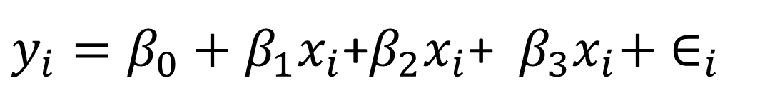
Principles of multivariable regression analysis
MVA relate 2 or more independent variables to an outcome (through mathematical expression)
age
exercise
Diet
Cholesterol
+
+
$y_{i}=β_{0}+β_{1}x_{i}$+$β_{2}x_{i}$+ $β_{3}x_{i}+ ∈_{i}$

Slide 3
Main multivariable models in biostatistics
Generalized linear models
A generalized linear model is made up of a linear predictor = relates mean to predictors
and two functions:
a link function (transform done on Y) = relates means of observations to predictors
a variance function (the distribution) = relates the means to the variances
age
exercise
Diet
Cholesterol
+
+

Slide 4
Main multivariable models in biostatistics
Type of MVA regression | Typical use
Multiple (general) linear | Predicting a quantitative response variable from 2 or more explanatory variables
Logistic | Predicting a categorical response variable from 2 or more explanatory variables
Poisson | Predicting a response variable representing counts from 2 or more explanatory variables
Cox proportional hazards | Predicting time to event (death, failure, relapse) from 2 or more explanatory variables
Time series | Modelling time series data with correlated errors
Discriminant function analysis | Predicting a group to which subjects belong (commonly use a score to classify obs into one of the categorical groups) - c.f Logistic regression

Slide 5
“Multivariate" or “Multivariable" analysis?
Often used interchangeably, but:
Multivariable – single outcome
Multivariable – multiple outcomes e.g. factor analysis

Slide 6
Purposes of Multivariable Analysis
Bivariate confirmation
Multivariable Confirmation
Screening
Creating Risk Scores
Quantifying Risk of Individual Variables

Slide 7
Common problems with MVA
Over-fitting or under-fitting
Nonconformity to a Linear Gradient
Violation of proportional hazards assumption
No report of tests for interaction
Unspecified coding of variables
Unspecified selection of variables
Collinearity of variables
Influential observations
Model validation

Slide 8
Over-fitting or under-fitting
Smoking
Death
Non smoker
Smoker

Slide 9
Over-fitting or under-fitting
Non smoker
Smoker
Died
Smoking
Diet
Death

Slide 10
Implications
 | Impact
Over-fitting | Unreliable risk estimates/ low precision
 | Spurious associations
Under-fitting (variable omission/ underpowered analysis) | Undetectable associations
 | Misleading results

Slide 11
Violation of PH assumption (Cox regression)
Hazard ratio – does not depend on time (on covariates only)
Methods for verification
Plot of `cumulative baseline hazard estimates on a log-scale’: Curves on the plot should be parallel with distance that is constant over time
Survival curves: if PH assumption is met survival curve of one group will not cross the survival curve of other group

Slide 12
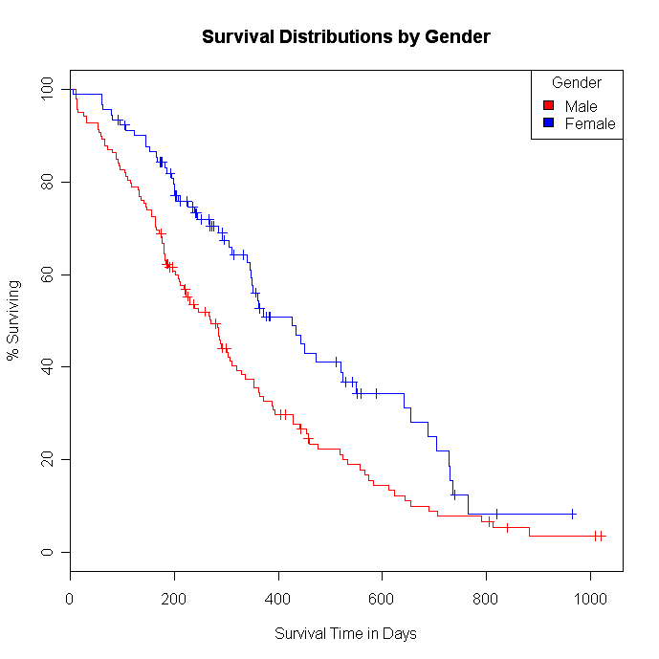
PH assumption

Slide 13
Checking PH assumption in `R’

Slide 14
No report of tests for interaction
To be covered in the next session

Slide 15
Unspecified coding
readers should always be notified of how the coding was used in a multivariable analysis:
Marginal (binary variable -1/+1) v.s. partial (binary variable 0/1) methods
Ordinal variable coding = could use “dummy” variable or integer values
Regression coefficients reported without concomitant citation of unit of coding e.g. single coefficient for age – could mean continuous variable or a dichotomous variable (<5/ above 5 years)

Slide 16
Unspecified Selection of Variables
Strategies of variable selection for MVA
Previous research
Clinical experience
Automated algorithms – esp. prognostic studies
Final model depends on the chosen selectin process

Slide 17
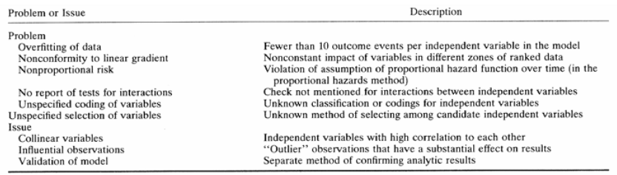
Summary

Slide 18
Principle MV models in `R’
multivariable_reg_practical.docx

Slide 19
Introduction – Interaction & Effect Modification

Slide 20
Interaction/ effect modification
Most of the outcomes (events) are determined (influenced) by more than one factor (e.g. body weight.)
Lifestyle
Body weight
Diet
Exercise

Slide 21
Interaction/ effect modification
Body weight
Diet
Looking at effect of each factor in turn = unrealistic
We should look at relationship of these factors to outcome at the same time
Body weight
Lifestyle
Body weight
Exercise

Slide 22
Interaction/ effect modification
Body weight
Diet
Lifestyle
Exercise
+
+
When we look at the relation of these factors (explanatory variables) to the outcome at the same time, ....
We will obtain the “independent effect” of explanatory variables to outcome.
We can also study the “interaction” (IA) between independent variables (Synergistic/Antagonistic IA)

Slide 23
Interaction
Body weight
Diet
Exercise
+
1 kg
1 unit + no change Diet effect
1 kg
No change + 1 unit Exercise effect

Slide 24
Interaction
Body weight
Diet
Exercise
+
1 kg
1 unit + no change Diet effect
1 kg
No change + 1 unit Exercise effect
2 kg
1 unit + 1 unit Combined effect (No IA)
2.5 kg
1 unit + 1 unit Combined effect (Syn. IA)
1.5 kg
1 unit + 1 unit Combined effect (Ant. IA)
IA= Interaction Syn. IA = Synergistic interaction Ant. IA = Antagonistic interaction

Slide 25
Detection/interpretation of interaction & effect modification
An interaction occurs when the product of two predictor variables is also a significant predictor (i.e. in addition to the predictor variables themselves)
Create an interaction term
Perform likelihood ratio test (LRT)

Slide 26
Testing for interaction in `R’
interaction practical.docx

Slide 27
Confounding and stratification

Slide 28
Exposures and outcomes
In an epidemiological study there is:
(a) the outcome of interest
(b) the primary exposure (or risk factor)
of interest
(c) other exposures that may influence
the outcome (potential confounders)

Slide 29
Exposures and outcomes
You will need to measure more than one exposure
Because you do not know which exposures are
likely to be risk factors for the disease i.e. you do not know which exposures are “primary”
Because some exposures
may ‘get in the way’ when trying to sort out a
relationship between
primary exposure and
outcomes i.e. they may
act as confounding factors

Slide 30

Question: Is alcohol consumption during pregnancy associated
with increased risk of low birthweight ?
Alcohol during pregnancy
exposure
Low birth weight
outcome
Diet during pregnancy
potential confounding factor

Slide 31
Confounding is about
ALTERNATIVE EXPLANATIONS
FOR AN EFFECT SEEN
- when an association between the Exposure under
investigation and Outcome is “mixed up” with the effect of
another exposure (or exposures)
- when the effects of the two exposures have not been considered separately

Slide 32
Definition: for a factor to be regarded as a confounder the rules are:
EXPOSURE OUTCOME
CONFOUNDER
1. The factor must be associated with the exposure being investigated
2. The factor must be independently associated with the disease being
investigated.
3. The confounder is not on the causal pathway.

Slide 33
How to deal with confounding
Need to display the data separately for each level
of the confounding factor
Then examine the measures of effect within each
level (or strata)
If they different from the “crude” measure of effect,
but similar to each other, this is evidence of confounding
BUT no test for confounding.

Slide 34
Example: Case-control study of coffee consumption and cancer
of the pancreas
Stratification

Slide 35
We have shown that the “stratified” measure of effect (in this case
odds ratios) are different from the “crude” measure of effect,
but similar to each other
Thus we have evidence that Smoking was acting as a confounding
factor
Question: What is the odds ratio for the effect of
Smoking on the risk of cancer of the pancreas?
Use data from table below:
Answer= (600 * 300 ) / (150* 150) = 8

Slide 36
“Adjusted “ OR=1.0
Crude OR=1.9
Exposure
Coffee
Outcome
Cancer of the pancreas
Crude OR=8.0
Another factor
Smoking

Slide 37
If we investigate the control data further, we can see
that the confounding factor
is associated with the exposure under investigation:
1 in 2 coffee drinkers are smokers
1 in 5 non-coffee drinkers are smokers

Slide 38
This example demonstrated complete confounding where ALL the association between coffee drinking and cancer of the pancreas could be“explained” by smoking
i.e: OR of 1.9 was reduced to 1.0
Other examples may give PARTIAL confounding
i.e: Rate Ratio of 2.5 was reduced to 2.0
But remember that measures of effect can go
UP as well as DOWN : NEGATIVE confounding

Slide 39
SECTION II

Slide 40
How to deal with confounding
At the Design Stage
Randomisation
Restriction
Matching
At the Analysis Stage
Stratification
Standardisation
Statistical modelling
eg logistic regression
But need to have collected the data…...

Slide 41
FURTHER ANALYSIS OF 2X2 TABLES
Mantel-Haenszel methods:
Mantel-Haenszel technique to obtain OR_{MH} adjusted for confounding factor.
2. Mantel-Haenszel χ² to test whether adjusted OR = 1.

Slide 42
Case-control study of coffee drinking and pancreatic cancer
Case Control
coffee yes 450 440
drinking no 300 410
Total 750 850
Crude OR = ad / bc = 450x410 / 440x300 = 1.40.
Suggests risk of pancreatic cancer associated with coffee drinking.

Slide 43
OR=1.40
Possible explanations:
Chance:
χ² (O-E) = 10.62, p=0.001 => chance is unlikely.
Bias:
OR = 1.40 does not represent the true OR.
Confounding:
OR = 1.40, but due to effect of other variable.
Causation:
OR = 1.40 reflects true association.

Slide 44
Look within stratum of confounding variable:
Smokers Non-smokers
case control case control
coffee yes 400 340 50 100
no 200 190 100 220
Total 600 530 150 320
Is smoking associated with increased risk of pancreatic cancer?
600 (80%) of the 750 cases are smokers
530 (62%) of the 850 controls are smokers

Slide 45
Look within stratum of confounding variable:
Smokers Non-smokers
case control case control
coffee yes 400 340 50 100
no 200 190 100 220
Total 600 530 150 320
Are coffee drinkers more likely to smoke?
Among controls…
340 of the 440 coffee drinkers are smokers (77%)
190 of the 410 non-coffee drinkers are smokers (46%)

Slide 46
Mantel-Haenszel Odds Ratio
Crude OR=1.4 is misleading. Calculate separate OR’s…
Smokers Non-smokers
case control case control
coffee yes 400 340 50 100
no 200 190 100 220
Total 600 530 150 320
OR = 400x190/340x200 = 1.12 OR = 50x220/100x100 = 1.10
But more interested in combined estimate of OR….

Slide 47
Mantel-Haenszel OR_{MH} is weighted average of OR’s in each stratum:
STRATUM 1 STRATUM 2
disease disease
Y N Y N
exposed Y a₁ b₁ | a₂ b₂ |
N c₁ d₁ | c₂ d₂ |
---------------- ---------------
| n₁ | n₂
OR_{MH} = a₁d₁/n₁ + a₂d₂/n₂ ∑ a_{i}d_{i}/n_{i} ---------------------- In general, ------------ b₁c₁/n₁ + b₂c₂/n₂ ∑ b_{i}c_{i}/n_{i}

Slide 48
disease disease
Y N Y N
exps Y a₁ b₁ | a₂ b₂ |
N c₁ d₁ | c₂ d₂ |
------------------ ------------------
| n₁ | n₂
OR_{MH} = a₁d₁/n₁ + a₂d₂/n₂ ---------------------- b₁c₁/n₁ + b₂c₂/n₂
disease disease
Y N Y N
exps Y 400 340 | 50 100 |
N 200 190 | 100 220 |
------------------ ------------------
| 1130 | 470
OR_{MH} = (400x190)/1130 + (50x220)/470 = 1.11
-------------------------------------------
(340x200)/1130 + (100x100)/470

Slide 49
disease disease
Y N Y N
exps Y 400 340 | 50 100 |
N 200 190 | 100 220 |
------------------ ------------------
| 1130 | 470
OR_{MH} = (400x190)/1130 + (50x220)/470 = 1.11
-------------------------------------------
(340x200)/1130 + (100x100)/470
Odds of coffee drinking is 11% higher among cases than controls.
This is the stratified estimate (recall crude OR was 1.4)

Slide 50
Significance test of stratified OR: Mantel-Haenszel χ² test
H₀: OR_{MH} = 1.
i.e. no association between exposure and disease within any strata.
For each table:
disease
Y N
exps Y a b | e
N c d | f
-------------------
g h | n
Observed value of a
ii) Expected value of a (assuming H₀: of no association): Ea = eg / n
iii) Variance of a (assuming H₀: no association): Va = efgh / {n²(n-1)}.

Slide 51
Calculate Ea and Va:
a Ea=eg/n Va=efgh/{n²(n-1)}
----------------------------------------------------------------------------------------
Smokers 400 392.9 63.7
Non-smokers 50 47.9 22.2
----------------------------------------------------------------------------------------
Total 450 440.8 85.9
Under H₀: difference between Σa and ΣEa should be small and follow χ² distribution (on 1.d.f):
χ²_{MH} = ( | ∑a - ∑Ea | - 0.5 )² / ∑Va
χ²_{MH} = (|450 - 440.8| - 0.5)² / 85.9 = 0.88 on 1 d.f.
P>0.30 No evidence of association

Slide 52
Mantel Haenszel using R
mymatrix1 <-matrix(c(400,340,200,190),nrow=2,byrow=TRUE)
colnames(mymatrix1) <- c("Disease","Control")
rownames(mymatrix1) <- c("Exposure","Unexposed")
print(mymatrix1) # to get the stratified table
mymatrix2 <- matrix(c(50,100,100,220),nrow=2,byrow=TRUE)
colnames(mymatrix2) <- c("Disease","Control")
rownames(mymatrix2) <- c("Exposure","Unexposed")
print(mymatrix2) # to get the stratified table

Slide 53
Confounding II (logistic regression analysis)

Slide 54
Practical - handling confounding

